Slide 1
The first non-surgical prolapse repair solution
Company Presentation
May 2018

Slide 2
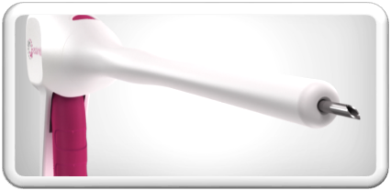
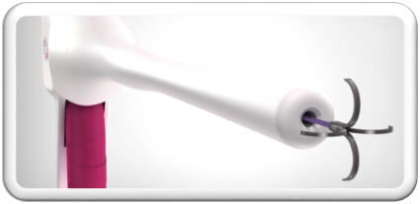
Our Vision
Provide disruptive, incision-free repair solutions for Pelvic Organ Prolapse

Slide 3
The company
Founded by senior medical professionals
Investors: Trendlines, private investors
Proof of concept in three models
FIH clinical study and FDA (Q1 2019)
Strong IP
Financing:
    $2 million round to commercialization - with strategic investor
    $850K in two tranches to FIH and FDA

Slide 4








I IN 3 WOMEN WILL SUFFER FROM
PELVIC ORGAN PROLAPSE IN THEIR LIFETIME

Slide 5

Pelvic Organ Prolapse:
A highly prevalent health problem
Poor
Quality Of Life
34 Million women are diagnosed annually worldwide
Aging
population
Obesity
X2
incidence
by 2050
Notes:
So, prolapse is a highly prevalent health problem that affects millions of women all over the world, and has a huge impact on the quality of life.
With the increasing rates of obesity and the aging population prolapse prevalence is expected to double in the next decades.

Slide 6

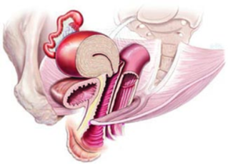
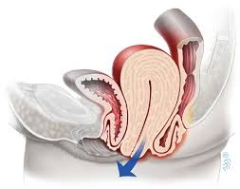
What is POP?
Pressure
Bulge
Fullness
Normal anatomy
Pelvic organ prolapse
Pain
Sexual dysfunction
Urine incontinence
Obstructed defecation

Slide 7

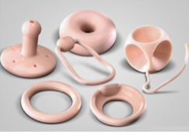

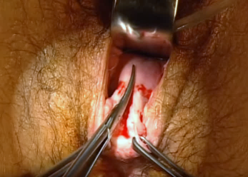
The unmet need in POP repair
Supportive devices
Surgery
No repair
Invasive
Temporary
Complications
            non-surgical “mid-path” repair solution
            is not available for:
            women that fail pessary treatment
            poor surgical candidates
            women reluctant to undergo surgery

Slide 8




Escala is addressing the unmet need
The first real minimally invasive, non-surgical repair solution for prolapse:
No cuts
Safe & rapid
  Minimal risk & patient discomfort
  Quick, 20 minute procedure
New point of care for prolapse:
  Shift from hospital to office-based procedures
  The only prolapse repair solution
  suitable for office setting

Slide 9
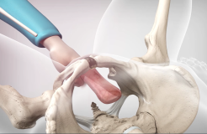
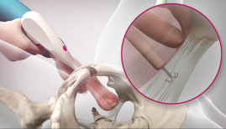
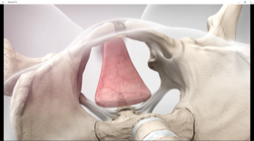
Position
The Escala 20 min. non-surgical,
repair procedure
Deploy
Restores anatomy and preserves organ function
in 3 steps
Secure

Slide 10
Incision free prolapse repair - video
https://www.youtube.com/watch?v=r_livY0vlIQ

Slide 11
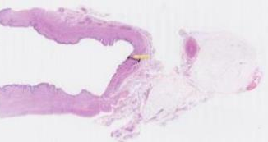
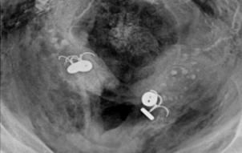
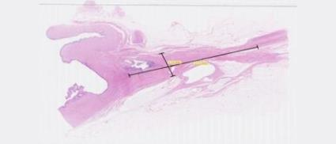
Successful Proof Of Concept
Bench
Animal
Animal study, control (Acute), no. 60*
Cadaver
Cadaver study, no. 18*
Animal study, chronic (12w.), no. 12*
* Overall number of anchor applications
Notes:
We’ve demonstrated Proof of Concept for safety and efficacy in three models: bench, animal and cadavers.

Slide 12

Market - USA
  3,300,000
  new POP patients each year
$2.9B
($1000/kit)
2,900,000
supportive/other
(mild-moderate)
400,000
repair surgeries
(severe cases)
$600M
($1500/kit)
Growth drivers:
        More women seeking care; less stigma/embarrassment
        Women seeking non-surgical options as a result of the “mesh phobia”
        Approximately 50,000 OBGYNs and Urologists (4th largest specialty)
* Barber et al. Epidemiology and outcome assessment of pelvic organ prolapse. Int Urogynecolol J (2013) 24:1783-1790

Slide 13

Significant market – Europe
  Over 227,000* surgical repair procedures
  European female population – 260 million
  Patients diagnosed with POP (2%)- 5.2 million
  Repair procedures (~8% of diagnosed) – 416,000
* 10 countries
* Haya et al. Prolapse and continence surgery in countries of the Organization for Economic Cooperation and Development in 2012. Am J Obstet Gynecol. June 2015.
Notes:
227K X 1500 = 340M
5M x 1000 = 5B
227K x 0.25 = 56K ➔ x 1500 = 85M
5M x 0.2 = 1M ➔ x 1000 = 1B

Slide 14

Significant market opportunity – China
100 million women >65 yrs.
> 30,000,000 women with POP
Over $1 billion worldwide market opportunity
Notes:
Looking at China: in the next years there will be over 100 million women over 65 years old. This means at least 30 million women with prolapse that will need treatment.

Slide 15
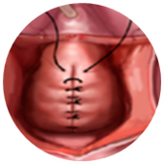
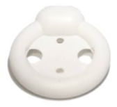

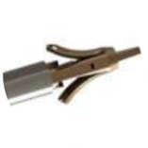
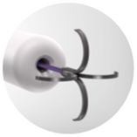


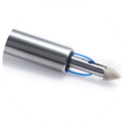

Competitive landscape
Non-surgical
Surgical
Supportive
Repair

Slide 16
Regulatory and reimbursement
RA
Reimbursement
FDA: 510K Class II.
Similar predicate devices
Unlikely to require clinical study
CE: Class IIb
Code 57282 description:
Colpopexy, vaginal; extra-peritoneal approach (sacrospinous, iliococcugeus)
Hospital outpatient allowed amount - $5,864
Code for office-based procedure will need to be developed.

Slide 17
Market dynamics
Women’s health 2010-2017
Announced | Target | Buyer | Product | Total value
May 2016 | S&N-Gynecology | Medtronic | Hysteroscopic tissue removal | $350M
August 2014 | Endosee | Cooper Surgical | Hysteroscopy | $44M
June 2014 | Iogyn | Boston Scientific | Hysteroscopic tissue removal | $90.3M
April 2013 | Conceptus | Bayer | Birth control | $1B
January 2013 | Verinata Health | Illumina | Prenatal test | $450M
January 2011 | Interlace | Hologic | Intrauterine fibroid removal | $125M
May 2010 | SenoRx | CR Bard | Breast biopsy systems | $193M

Slide 18






Designed to meet all stakeholders needs
safe & quick
a new repair alternative
easy to perform
untapped patient population
lower costs
more patients

Slide 19




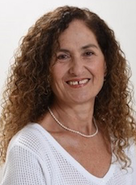

Management and BOD
Edit Goldberg, DMD, MBA
CEO
Over 15 years of medical device industry experience in senior development, strategic and business development positions.
Jonathan Schanin, MSc, MBA
CTO, Director
Senior corporate manager, vast experience in developing & marketing medical devices and pharmaceutical packaging. Technion graduate.
Douglas Scherr, M.D.
Founder, medical advisor, director
Professor of Urology. Clinical Director, Urologic Oncology, Weill Medical College of Cornell University.
Roger Goldberg, M.D., MPH
Founder, medical advisor, director
Clinical Associate Professor. Director, Division of Urogynecology. The University of Chicago Pritzker School of Medicine.
Nitza Kardish, Ph.D.
    Director
    CEO Trendlines Incubators Israel
    Vast experience in leading life science companies
Todd Dollinger
Director
    Chairman and CEO, The Trendlines Group
    Chairman, Trendlines Medical

Slide 20

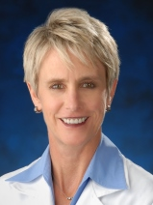


Distinguished SAB
Peter Rosenblatt, M.D.
Assistant Professor of Obstetrics, Gynecology and Reproductive Biology. Director of Urogynecology and Pelvic Reconstructive Surgery.
Mount Auburn Hospital, Cambridge, MA
Karen Noblett, M.D.
Clinical Professor, Chair Obstetrics & Gynecology, School of Medicine
Director, Division of Urogynecology and Female Pelvic Medicine and Reconstructive Surgery
University of California, Irvine, CA
Patrick Culligan, M.D.
Professor of Urology in Obstetrics & Gynecology, Director of Urogynecology, Attending Urologist New York-Presbyterian Hospital
(Weill Cornell campus)
David Shveiky, M.D.
Female Pelvic Medicine and Reconstructive Surgery department of Obstetrics and Gynecology.
Hadassah MC, Jerusalem, Israel

Slide 21
Investment opportunity & road map
Valid clinical need Large market Short time to market
Clinical study
Commercialize
FDA
CE
Clinical study
Funding
FIH study
FDA sub.
Strategic partnership
IIA funding
V&V
2020
R&D
Manufacturing
Internal round
Private investors
2019
2018
R&D
POC
2017
Company start
IIA funding
2016
2015
Dec 2014

Slide 22
Funding and use of funds
Investments to date - $1.1M (IIA - non dilutive grants, Trendlines, angels)
Major shareholders: Trendlines, Dr. Scherr, Dr. Goldberg
Use of proceeds through 2019 ($2M financing round):
    FDA (Q4 ‘18) and FIH (Q2 ‘19) - $1050K
    G&A - $540K
    Legal, IP, Corp - $225K
    CE

Slide 23






Why Escala?
First non-surgical repair solution for prolapse
Successful POC
Large market opportunity
Experienced team
Protective IP
12 months from funding to market
Notes:
So, I’ll leave you with this summary and will be happy to address any questions. Thank you.

Slide 24
Thank you
Edit Goldberg
edit@escalamedical.com
+972 544 545276

